Slide 1
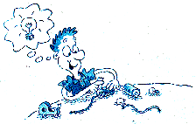
Electrical Circuits

Slide 2
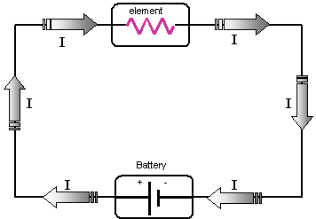
Electrical Circuits
A Circuit is a closed conducting loop through which an electric current can flow.

Slide 3
Electrical Circuits - Parts
Source of Energy – battery, thermocouple, electric generator, photocell
Resistance (load) – device that uses energy – light bulb, appliance, machine, motor
Notes:
Photocell - a solid-state device that converts light into electrical energy by producing a voltage, as in a photovoltaic cell, or uses light to regulate the flow of current, as in a photoconductive cell: used in automatic control systems for doors, lighting
Thermocouple - a kind of thermometer consisting of two wires of different metals that are joined at both ends; one junction is at the temperature to be measured and the other is held at a fixed lower temperature; the current generated in the circuit is proportional to the temperature difference

Slide 4
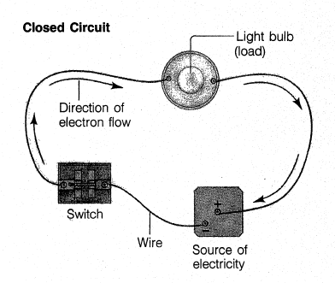
Electrical Circuits - Parts
Wires – serves as a path to conduct the electrons
Switch – opens (off) and closes (on) circuit
Notes:
Photocell - a solid-state device that converts light into electrical energy by producing a voltage, as in a photovoltaic cell, or uses light to regulate the flow of current, as in a photoconductive cell: used in automatic control systems for doors, lighting
Thermocouple - a kind of thermometer consisting of two wires of different metals that are joined at both ends; one junction is at the temperature to be measured and the other is held at a fixed lower temperature; the current generated in the circuit is proportional to the temperature difference

Slide 5
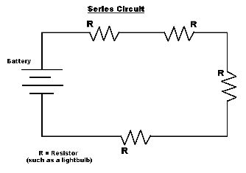
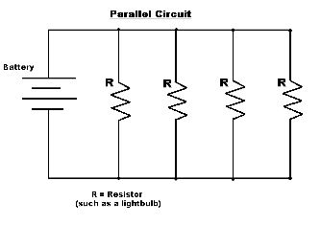
Circuit Diagrams
Notes:
Photocell - a solid-state device that converts light into electrical energy by producing a voltage, as in a photovoltaic cell, or uses light to regulate the flow of current, as in a photoconductive cell: used in automatic control systems for doors, lighting
Thermocouple - a kind of thermometer consisting of two wires of different metals that are joined at both ends; one junction is at the temperature to be measured and the other is held at a fixed lower temperature; the current generated in the circuit is proportional to the temperature difference

Slide 6
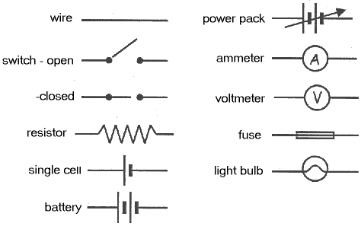
Circuit Diagram Symbols
Notes:
Photocell - a solid-state device that converts light into electrical energy by producing a voltage, as in a photovoltaic cell, or uses light to regulate the flow of current, as in a photoconductive cell: used in automatic control systems for doors, lighting
Thermocouple - a kind of thermometer consisting of two wires of different metals that are joined at both ends; one junction is at the temperature to be measured and the other is held at a fixed lower temperature; the current generated in the circuit is proportional to the temperature difference

Slide 7
Types of Electrical Circuits
Series
All the parts of an electric circuit are connected one after another
Only 1 path for the electron to take

Slide 8
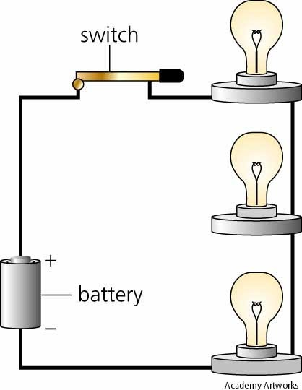
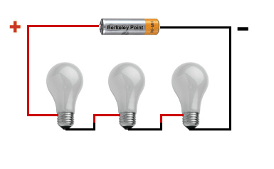
Series Circuit

Slide 9
Types of Electrical Circuits
Parallel
Different parts of an electric circuit on separate branches
Several paths for electrons to take

Slide 10
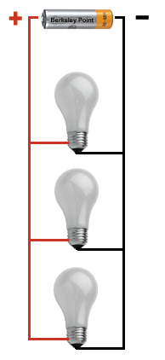
Parallel Circuit

Slide 11
Series Circuit
Disadvantage: if there is a break anywhere in the circuit, the entire circuit is open and no current can flow
Ex: cheap holiday lights

Slide 12
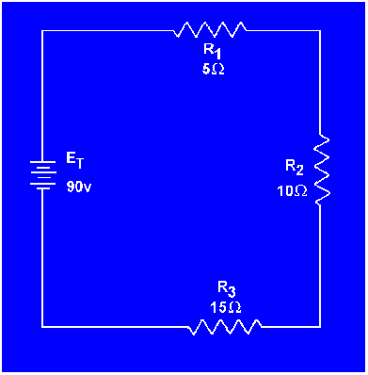
Series Circuit

Slide 13
Parallel Circuit
If there is a break in one branch, the electrons and current can still flow through the other branches
Ex: more expensive holiday lights

Slide 14
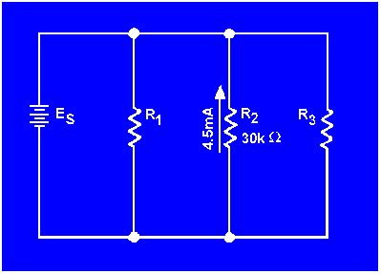
Parallel Circuit

Slide 15
Magnetism

Slide 16
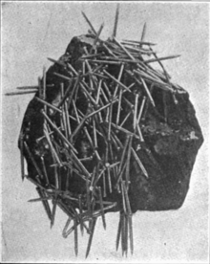
Magnetism
Discovered by the Greeks in Magnesia, Turkey
Lodestone
Refers to the unseen forces of attraction and repulsion between of magnets

Slide 17
Magnetism
Magnetic Force – magnets exert force on each other
The closer they are, the stronger the force
A magnet is surrounded by a magnetic field.

Slide 18
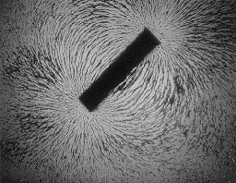
Magnetic Field
Exerts a force on other magnets and objects made of magnetic materials
Represented by magnetic field lines
Have direction

Slide 19
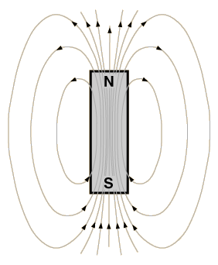
Magnetic Field and Poles
Poles are where the magnetic force exerted by the magnet is the strongest
Field lines are close together
North Pole
South Pole

Slide 20
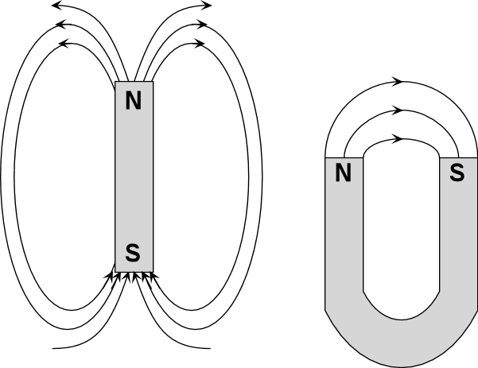
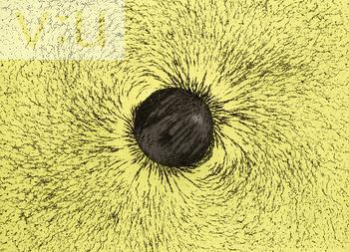
Magnetic Poles
Bar
Magnet
Horseshoe
Magnet
Disk
Magnet

Slide 21
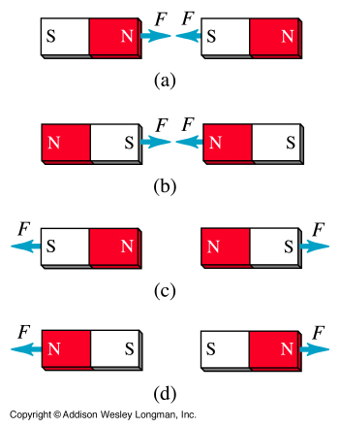
How Do Magnets Interact?
Like poles repel
Opposite poles attract

Slide 22
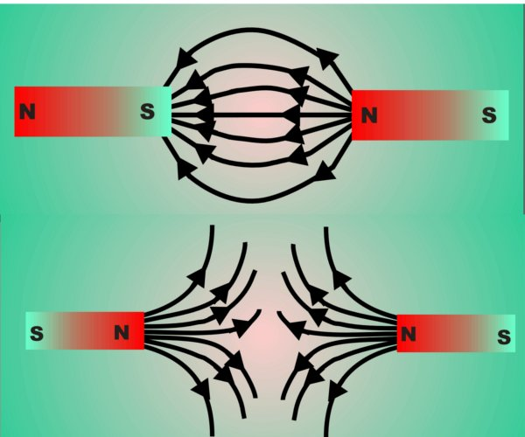
How Do Magnets Interact?
When 2 magnets are brought close to each other, their magnetic fields combine to produce a new magnetic field.

Slide 23
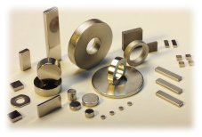
Magnetic Materials
Iron (Best)
Cobalt
Nickel

Slide 24
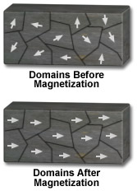
Magnets on the Atomic Scale
Magnetic Domains: Groups of atoms with aligned magnetic poles
A non-magnetic piece of iron (ex. a nail) can be made into a temporary magnet if the domains are aligned

Slide 25
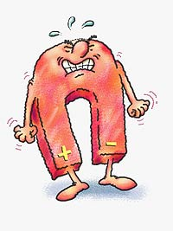
Can a Magnet Lose Its Magnetism?
YES!
If a magnet is heated, the atoms can begin to move fast enough to mess up the alignment of domains

Slide 26
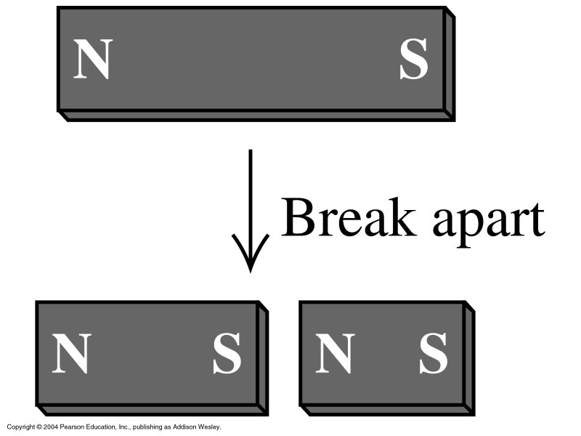
Can a Pole be Isolated?
NO!
When a magnet is broken, each piece will still have a north pole and a south pole

Slide 27
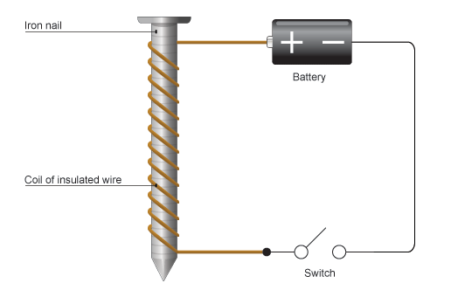
Electromagnets
Temporary magnet
Made by wrapping a wire coil around an iron core, and then running a current through the wire.

